Slide 1
Cancer Biology Biol 445
Spring 2020
Dr. Heidi Super
Lecture 28
4-17-2020

Slide 2
Announcements
Quiz 4---Please check blackboard for your scores and my comments. Please let me know if you can’t see something---I gave scores for each question and comments on most answers. You should see more than just an overall score.
Please email me to discuss any questions you may have. I’m happy to have a second look.

Slide 3
Where were we?
Radon---North Dakotans have considerable risk of exposure to a radioactive gas. Be educated.
Radium use in watch dials is a tragic story in history.
Cancer screening---Cologard test…
Detecting tumor antigens in blood---many tests us PCR---the same technology for finding Covid-19 specific DNA sequence in infected individuals.

Slide 4
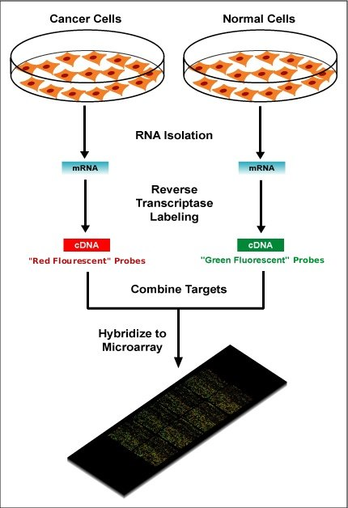
Detecting abnormal gene expression in cancer
Microarray—for detecting amount of mRNA expressed in tumor vs. normal cells (looking at thousands of different genes at once)
Microarray—for detecting amount of protein expressed in tumor vs. normal cells (looking at thousands of different proteins at once)
Direct sequencing (high throughput) to look for mutations in thousands of genes at once (even every gene at once)

Slide 5
Looking at a smaller number of relevant genes.

Slide 6
Oncotype DX—breast cancer
A genetic test developed from lots of gene expression analysis experiments
One test looks at a relevant set of 21 genes, to predict recurrence probability in breast cancer that is ER+, Her2-, with or without signs of metastasis (breast cancer cells in nearby lymph nodes)

Slide 7
A second test looks at 12 genes for mutations or changes in expression in ductal carcinoma in situ (DCIS). A type of breast cancer that occurs in milk duct cells and shows not metastasis. Figure 11-5
*In both type of tests---the genetic analysis helps the physicians recommend the best course of treatment.

Slide 8
Oncotype Dx for other cancers…
Since I last taught this course, Oncotype DX tests have been developed for colon and prostate cancer too!
https://www.oncotypeiq.com/en-US
https://www.genomichealth.com/en-US/oncotype_iq_products/oncotype_dx.aspx

Slide 9
Tests like the Oncotype tests belong to a set of newer approaches to health care called ”precision medicine”. In general it uses DNA/gene analysis to predict risk for diseases, intervention and treatment responses.

Slide 10
Cancer treatment
Surgery---oldest cancer treatment---still important. In many cases radiation or chemotherapy can only be successful if the tumor size is reduced in size.
Surgery has had an interesting history. I highly recommend reading the Emperor of All Maladies. (Also PBS special)

Slide 11
At one time, surgery was really the only “treatment” for cancer.
i.e. mastectomy removes obvious tumor tissue as well as normal tissue. Surgeons knew, complete removal of all cancer cells was tricky---so “radical mastectomy” became common. (This left a woman without lymph nodes, muscle, connective tissue. Disfiguring, life changing, and without much reduction in recurrence of the cancer) ☹

Slide 12
Alternatives to traditional surgery
Lumpectomy rather than mastectomy or other full removal of breast.
Laser surgery
Cryosurgery
Electro surgery
Ultrasound surgery

Slide 13
Radiation therapy
Planned, controlled, repeated exposure of tumor cells to ionizing radiation (X-ray or other source)
Most patients receive radiation in small, repeated, daily doses.
Why?
Figure 11-7 reminds us…

Slide 14
Repeated doses

Slide 15
Mechanism of killing cancer cells
1. p53 initiated apoptosis.
(p53-mutants)
2. Mitotic death/catastrophe---recall ionizing radiation can cause DNA breaks. Cells cannot properly complete mitosis with fragmented DNA. Cells die while in the process of dividing at later stage---recall spindle checkpoint.

Slide 16
Limitations of radiation
p53—mediated cell death is problematic since p53 is often mutated and non-functional in many cancers!
Mitotic death—only tumors with significantly high cell division rates are responsive. Slow-growing tumors less responsive
Some cancers are radiation resistant.
Table 11-1

Slide 17
Minimizing radiation exposure to healthy tissues.
Radiation planning---personalized immobilization plan. Computer guided delivery. Shielding of healthy tissues.
Brachytherapy---insertion of a small radioactive source directly into/near a tumor.

Slide 18
Enhancing radiation effectiveness
Raising temperature of the tumor tissue
Hyperthermia—administered during or after radiation enhances the killing effect of radiation.
Limited to tissues fairly close to surface
Combining with chemotherapy drugs.
Drugs which are taken up by tumor cells which a low in oxygen. (hypoxic radiosensitizers)

Slide 19
So….radiation is both a carcinogen and a cancer treatment/cure….be sure to think about the unique nature of cancer as a disease.

Slide 20
Chemotherapy
Name for any chemical drug, administered systemically to treat disease. Not just cancer treatment.
Often a component of cancer therapy combined with surgery and/or radiation
Basic mechanisms—kill cancer cells or interfere with ability to divide or support growth.

Slide 21
Classes of cancer chemotherapy
Antimetabolites
Alkylating agents
Antibiotics
Plant-derived enzyme or cell structure inhibitors
Hormone/antihormone therapy

Slide 22
Antimetabolites—disrupt normal metabolism pathways.
Molecular resemblance (analogs) to normal metabolites. Fool enzymes into binding, but the normal chemical reaction does not occur.
Many inhibit essential synthetic pathways (DNA and/or nucleotide synthesis)
Very first type of chemotherapy used

Slide 23
Father of chemotherapy
Sydney Farber:
Used a folic acid “disruptor”, aminopterin, to treat children with acute lymphoblastic leukemia.
Folic acid—is an essential B vitamin that is needed in the pathway for nucleotide synthesis—so it is important for DNA synthesis and DNA repair---basically healthy cells.
Aminopterin was effective—it killed the rapidly dividing leukemia cells, but only temporarily—Why?

Slide 24
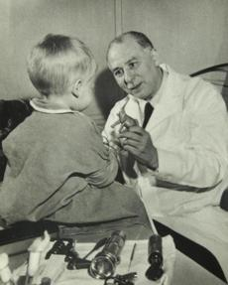
http://en.wikipedia.org/wiki/History_of_cancer_chemotherapy

Slide 25
Folic acid (a B-vitamin) is essential for synthesis of DNA bases. Inhibition of folic acid metabolism is one of the most common methods for killing cells.
Methotrexate (replaced aminopterin)--useful drug in cancer—leukemia, breast, bladder, bone. Also used in autoimmune diseases.
Methotrexate is a folic acid antagonist---it interrupts the normal activity of folic acid

Slide 27
??
What is the target cell/cells in drugs used for autoimmune diseases?
How are autoimmune diseases similar to cancer?

Slide 28
Other antimetabolite analogs
Base analogs—discussed as mutagens previously
5-fluorouracil
Cytorabine
Mercaptopurine
Thioguanine
Mechanism=incorporate into DNA disrupt or lead to incorrect DNA basepairing

Slide 29
Alkylating agents:
Discussed as mutagens previously.
Sulfur mustard first recognized alkylating agent
Nitrogen mustard
Soldiers exposed to these gasses who survived, eventually developed anemia or leukemia. Had an effect on lymphocytes. Showed potential in killing hematopoietic cells.

Slide 30
Alkylating agents developed related to nitrogen mustard.
In common use:
Melphalan
Chlorambucil
cyclophosphamide
nitrosourea

Slide 31
These agents attach directly to DNA---become DNA adducts
Results in base mis pairing
Cross linking of DNA strands

Slide 32
Alkylating agents and platinum compounds
Direct attachment of these agents to DNA
Results in base mis pairing
Cross linking of DNA strands
Cisplantin—continues to be one of the most effective drugs for cancer chemotherapy.
Both disrupt DNA replication and trigger apoptosis.

Slide 33
Other anticancer activities
Doxorubicin
Duanorubicin
A class of agents that wedge themselves into DNA (intercalate) and then inhibit the activity of DNA topoisomerases. The result is DNA strand breaks.
Mitomycin-Cross-linking agent
Bleomicin—induces DNA strand breaks.

Slide 34
Chapter 5--review
We did not use chapter 5 figures/tables much, and spoke fairly generally about chemical carcinogens.
Be sure to look at Table 5-2 and the 5 mechanisms of chemical carcinogenesis.
Read about the many ways chemicals attack and alter DNA. Figs. 5-11 and 5-12

Slide 35
Keep in mind, some of the same chemicals or chemical types we might associate with causing carcinogenic mutations are effective cytotoxic cancer chemotherapies.
We weigh the level of toxicity to non-cancer cells against the life-saving or extending effect of killing the cancer cells.

Slide 36
Tragically, some chemotherapies that cure one type of cancer, result in a second, therapy-induced cancer---often leukemia.
For example, some topoisomerase inhibitors that save the life of people with several different types of cancer, induces a fairly rapid and aggressive leukemia in 5-15% of patients.

